Slide 1
Deep Learning for images
Lenses of Deep Learning

Slide 2
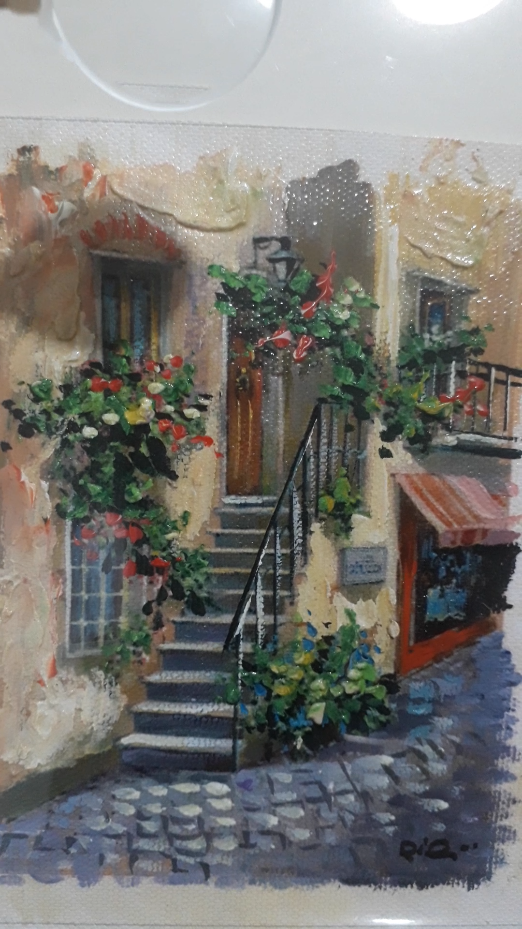

Slide 3
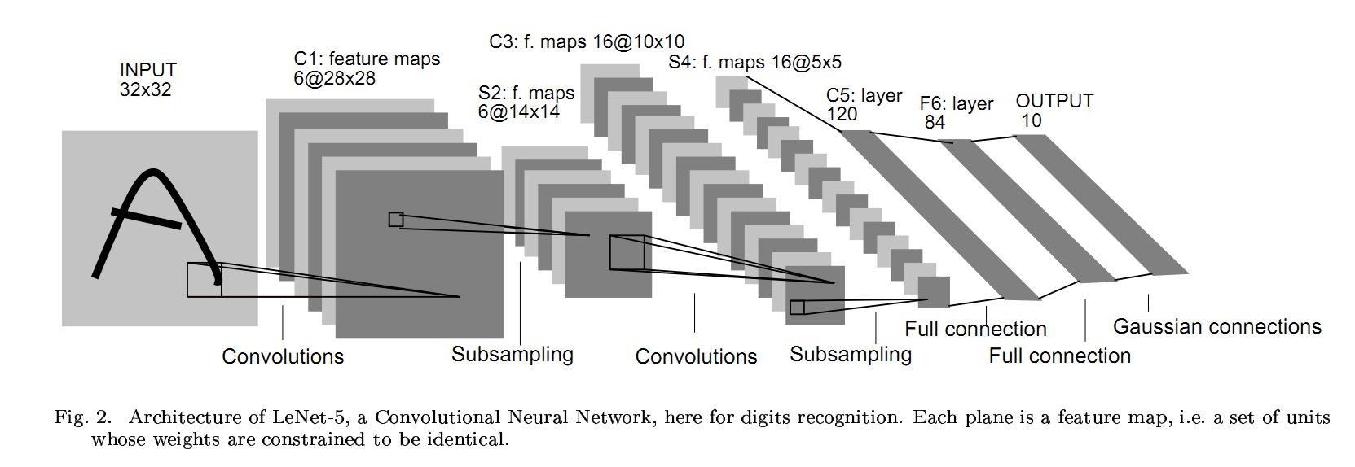
Overall architecture of CNN
https://world4jason.gitbooks.io/research-log/content/deepLearning/CNN/Model%20&%20ImgNet/lenet.html

Slide 4
First we learn about
Image filtering

Slide 5
The Sliding window - image filtering
2 | 5 | 1 | 3 | 4 | 8 | 9
6 | 8 | 9 | 2 | 3 | 7 | 9
5 | 9 | 5 | 9 | 0 | 8 | 9
7 | 1 | 3 | 4 | 6 | 9 | 5
3 | 9 | 2 | 3 | 7 | 1 | 3
8 | 6 | 0 | 1 | 3 | 9 | 2
7 | 3 | 4 | 2 | 4 | 8 | 6
13 | 16 | 18 | 10 | 18 | 28 | 26
21 | 37 | 25 | 26 | 16 | 35 | 33
27 | 28 | 35
our lens
operations = sum of pixels

Slide 6
The Sliding window - image filtering
2 | 5 | 1 | 3 | 4 | 8 | 9
6 | 8 | 9 | 2 | 3 | 7 | 9
5 | 9 | 5 | 9 | 0 | 8 | 9
7 | 1 | 3 | 4 | 6 | 9 | 5
3 | 9 | 2 | 3 | 7 | 1 | 3
8 | 6 | 0 | 1 | 3 | 9 | 2
7 | 3 | 4 | 2 | 4 | 8 | 6
6 | 8 | 9 | 4 | 8 | 9 | 9
8 | 9 | 9 | 9 | 7 | 9 | 9
9 | 9 | 9
our lens
operations = max of pixels

Slide 7
The Sliding window - image filtering
2 | 2 | 1 | 0 | 2 | 1 | 1
3 | 2 | 1 | 2 | 3 | 2 | 0
1 | 0 | 2 | 1 | 0 | 2 | 1
1 | 0 | 2 | 1 | 0 | 2 | 1
2 | 1 | 1 | 0 | 2 | 2 | 1
1 | 2 | 2 | 0 | 2 | 3 | 2
2 | 1 | 0 | 2 | 2 | 0 | 2
9 | 9 | 5 | 5 | 8 | 7 | 3
11 | 10 | 9 | 8 | 12 | 10 | 4
6 | 5 | 8
 | 1
1 | 2 | 1
 | 1
our lens
operations = weighted sum

Slide 8
Dilation as an image filter
0 | 0 | 0 | 0 | 0 | 0 | 0
0 | 0 | 1 | 0 | 0 | 0 | 0
0 | 1 | 1 | 1 | 0 | 0 | 0
0 | 0 | 1 | 1 | 0 | 0 | 0
0 | 0 | 0 | 1 | 0 | 0 | 0
0 | 0 | 0 | 1 | 0 | 0 | 0
0 | 0 | 0 | 0 | 0 | 0 | 0
0 | 0 | 1 | 0 | 0 | 0 | 0
0 | 1 | 1 | 1 | 0 | 0 | 0
1 | 1 | 1 | 1 | 1 | 0 | 0
0 | 1 | 1 | 1 | 1 | 0 | 0
0 | 0 | 1 | 1 | 1 | 0 | 0
0 | 0 | 1 | 1 | 1 | 0 | 0
0 | 0 | 0 | 1 | 0 | 0 | 0
our lens
operations = max pixel

Slide 9
Mean filter
1 = white pixel, 0 = black pixel
0 | 0 | 0 | 0 | 0 | 0 | 0
0 | 0 | 1 | 0 | 0 | 0 | 0
0 | 1 | 1 | 1 | 0 | 0 | 0
0 | 0 | 1 | 1 | 0 | 0 | 0
0 | 0 | 0 | 1 | 0 | 0 | 0
0 | 0 | 0 | 1 | 0 | 0 | 0
0 | 0 | 0 | 0 | 0 | 0 | 0
0 | 0 | 1/4 | 0 | 0 | 0 | 0
0 | 2/5 | 2/5 | 2/5 | 0 | 0 | 0
1/4 | 2/5 | 1 | 3/5 | 1/5 | 0 | 0
0 | 2/5 | 2/5 | 4/5 | 1/5 | 0 | 0
0 | 0 | 2/5 | 3/5 | 1/5 | 0 | 0
0 | 0 | 1/5 | 2/5 | 1/5 | 0 | 0
0 | 0 | 0 | 1/5 | 0 | 0 | 0
our lens
operations = mean

Slide 10
Mean filter
0 | 0 | 1/4 | 0 | 0 | 0 | 0
0 | 2/5 | 2/5 | 2/5 | 0 | 0 | 0
1/4 | 2/5 | 1 | 3/5 | 1/5 | 0 | 0
0 | 2/5 | 2/5 | 4/5 | 1/5 | 0 | 0
0 | 0 | 2/5 | 3/5 | 1/5 | 0 | 0
0 | 0 | 1/5 | 2/5 | 1/5 | 0 | 0
0 | 0 | 0 | 1/5 | 0 | 0 | 0
0 | 0.16 | 0.36 | 0.27 | 0 | 0 | 0
0.27 | 0.24 | 0.49 | 0.28 | 0.12 | 0 | 0
0.36 | 0.49 | 0.52 | 0.6 | 0.2 | 0.04 | 0
0.15 | 0.24 | 0.4 | 0.52 | 0.28 | 0.04 | 0
0 | 0.16 | 0.32 | 0.48 | 0.24 | 0.04 | 0
0 | 0.04 | 0.2 | 0.32 | 0.16 | 0.04 | 0
0 | 0 | 0.1 | 0.15 | 0.1 | 0 | 0
our lens
operations = mean

Slide 11
original image
344 x 332 pixels
mean 1 time
mean 2 times
mean 3 times
mean 10 times
mean 1 time with radius 20

Slide 12
The Sliding window - image filtering
2 | 2 | 1 | 0 | 2 | 1 | 1
3 | 2 | 1 | 2 | 3 | 2 | 0
1 | 0 | 2 | 1 | 0 | 2 | 1
1 | 0 | 2 | 1 | 0 | 2 | 1
2 | 1 | 1 | 0 | 2 | 2 | 1
1 | 2 | 2 | 0 | 2 | 3 | 2
2 | 1 | 0 | 2 | 2 | 0 | 2
2 | 2 | 1 | 1 | 1 | 1 | 1
2 | 2 | 2 | 1 | 2 | 2 | 1
1 | 1 | 1
our lens
operations = median filter

Slide 13
Median filter
original image
344 x 332 pixels
median filter
radius 4
mean filter
radius 4

Slide 14
Gaussian filter
A weighted window
0.0075 | 0.01 | 0.02 | 0.01 | 0.0075
0.01 | 0.04 | 0.1 | 0.04 | 0.01
0.02 | 0.1 | 0.25 | 0.1 | 0.02
0.01 | 0.04 | 0.1 | 0.04 | 0.01
0.0075 | 0.01 | 0.02 | 0.01 | 0.0057
Put in weights with a gaussian profile -> a Gaussian filter

Slide 15
original image
344 x 332 pixels
filtered with sigma = 2 pixels
filtered with sigma = 8 pixels

Slide 16
-1 | 0 | 1
-1 | 0 | 1
-1 | 0 | 1
Edge filter
1 | 1 | 1 | 1 | 5 | 5 | 5 | 5
1 | 1 | 1 | 1 | 5 | 5 | 5 | 5
1 | 1 | 1 | 1 | 5 | 5 | 5 | 5
1 | 1 | 1 | 1 | 5 | 5 | 5 | 5
1 | 1 | 1 | 1 | 5 | 5 | 5 | 5
1 | 1 | 1 | 1 | 5 | 5 | 5 | 5
1 | 1 | 1 | 1 | 5 | 5 | 5 | 5
0 | 0 | 4 | 4 | 0 | 0
0 | 0 | 4 | 4 | 0 | 0
0 | 0 | 4 | 4 | 0 | 0
0 | 0 | 4 | 4 | 0 | 0
0 | 0 | 4 | 4 | 0 | 0
0 | 0 | 4 | 4 | 0 | 0
0 | 0 | 4 | 4 | 0 | 0

Slide 17
-1 | 0 | 1
-1 | 0 | 1
-1 | 0 | 1
-1 | -1 | -1
0 | 0 | 0
1 | 1 | 1

Slide 18
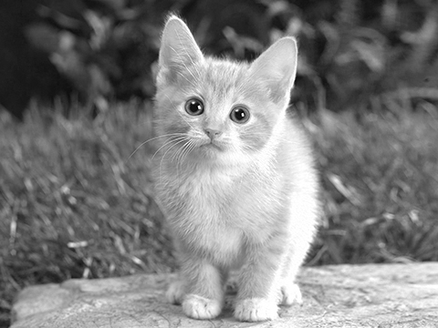
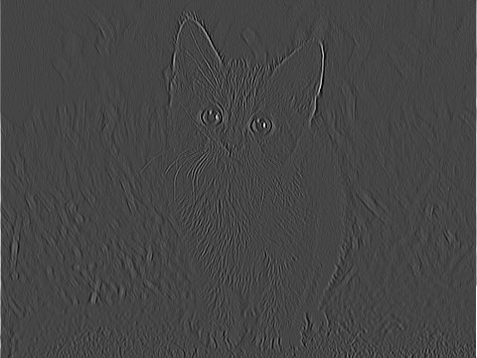
-1 | 2 | -1
-1 | 2 | -1
-1 | 2 | -1

Slide 19
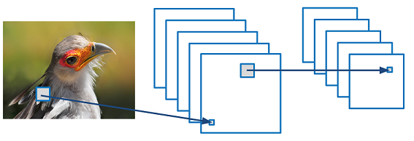

Convolutional Neural Networks (CNNs)
Convolution operation
Hyperparameters
Filter height
Filter width
Stride height
Stride width
# of filters
# of layers
1 | 0 | 1
0 | 1 | 0
1 | 0 | 1
Convolved
Feature
Filter
Image

Slide 20
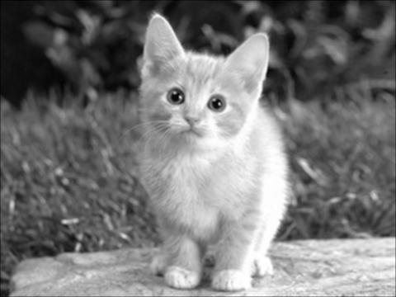

Effect of Filter Size
7x7 Filter
1 | 1 | 1 | 1 | 1 | 1 | 1
1 | 1 | 1 | 1 | 1 | 1 | 1
1 | 1 | 1 | 1 | 1 | 1 | 1
1 | 1 | 1 | 1 | 1 | 1 | 1
1 | 1 | 1 | 1 | 1 | 1 | 1
1 | 1 | 1 | 1 | 1 | 1 | 1
1 | 1 | 1 | 1 | 1 | 1 | 1
3x3 Filter
1 | 1 | 1
1 | 1 | 1
1 | 1 | 1

Slide 21
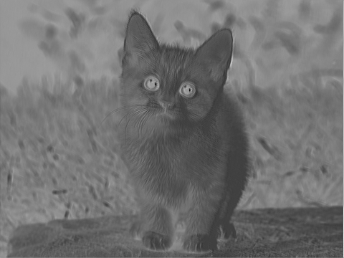
Learning Filter Weights
Random Weights
Learned Weights
0.5 | 1.1 | -1.6
-1.0 | 0.1 | -0.6
1.0 | 0.3 | -1.9
-1.0 | 2.0 | -1.0
-1.0 | 2.0 | -1.0
-1.0 | 2.0 | -1.0

Slide 22
Simplest convolutional neural network
x3 * w3
x3
x2
x6 * w6
x1
x6
x5
x9 * w9
x4
x9
x8
x7

Slide 23
Simplest convolutional neural network
x3 * w3
x3
x2 * w2
x2
x6 * w6
x1
x6
x5 * w5
x5
x9 * w9
x4
x9
x8 * w8
x8
x7

Slide 24
Simplest convolutional neural network
x3 * w3
x3
x2 * w2
x2
x1 * w1
x6 * w6
x1
x6
x5 * w5
x5
x4 * w4
x9 * w9
x4
x9
x8 * w8
x8
x7 * w7
x7

Slide 25
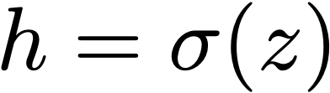
Simplest convolutional neural network
x1*w1 + x2*w2 + x3*w3 +
x4*w4 + x5*w5 + x6*w6 +
x7*w7 + x8*w8 + x9*w9 + b = z
x3 * w3
x3
x2 * w2
x2
x1 * w1
x6 * w6
x1
x6
x5 * w5
x5
x4 * w4
x9 * w9
z
x4
x9
x8 * w8
x8
x7 * w7
x7
w1 | w2 | w3
w4 | w5 | w6
w7 | w8 | w9
this is
our lens

Slide 26
Simplest convolutional neural network
x3
x2
x1
x6
W
x5
z
x4
x9
x8
x7

Slide 27
Simplest convolutional neural network
W

Slide 28
Simplest convolutional neural network
W

Slide 29
Simplest convolutional neural network
W

Slide 30
Simplest convolutional neural network
W

Slide 31
Simplest convolutional neural network
W

Slide 32
Simplest convolutional neural network
W

Slide 33
Simplest convolutional neural network
W

Slide 34
Simplest convolutional neural network
W

Slide 35
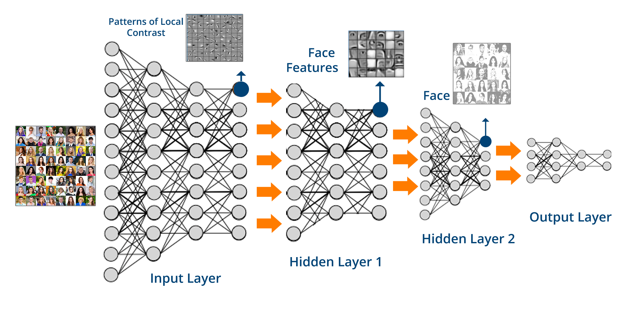
What is Deep Learning?
Multi-level representation learning

Slide 36
Overall architecture of CNN
https://world4jason.gitbooks.io/research-log/content/deepLearning/CNN/Model%20&%20ImgNet/lenet.html

Slide 37
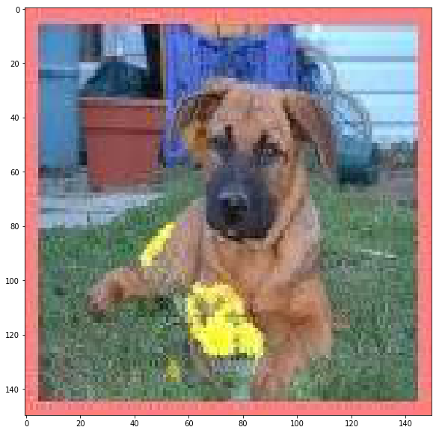
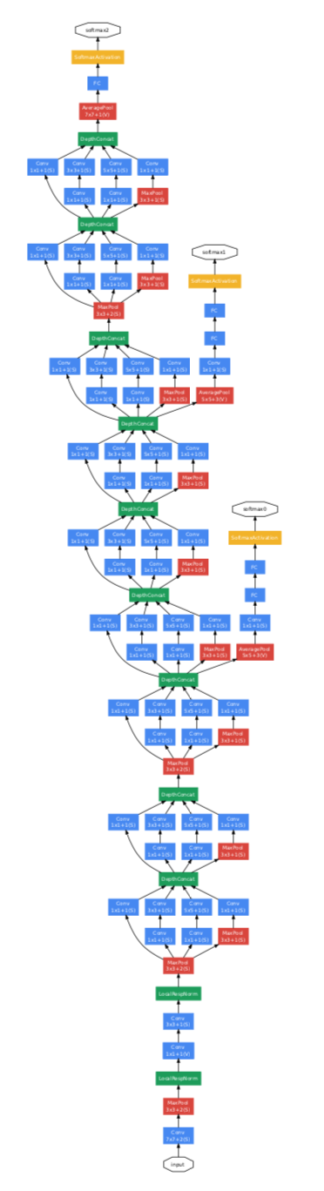
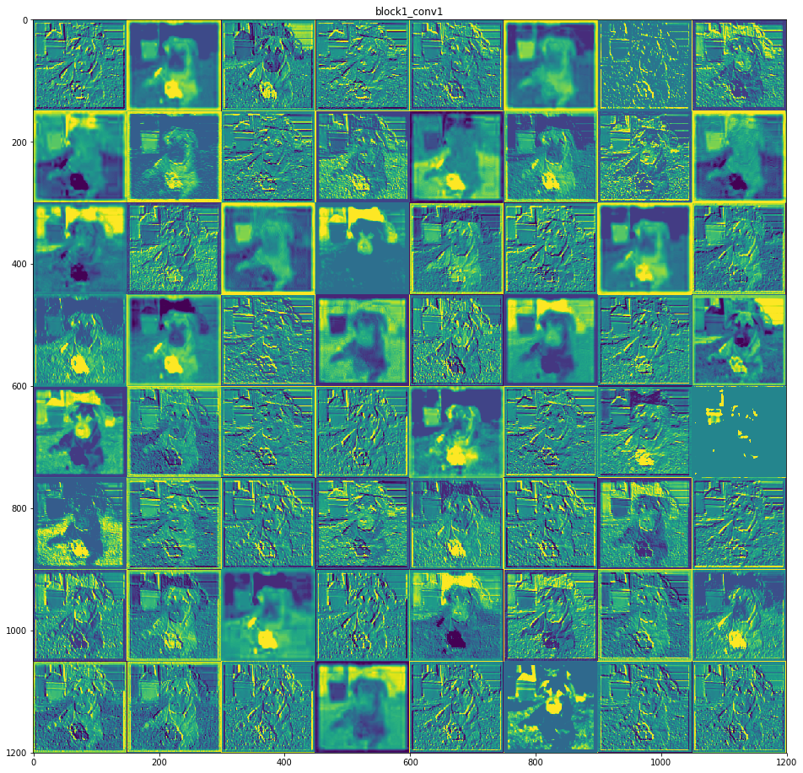
Block1_conv1
output
input
input

Slide 38
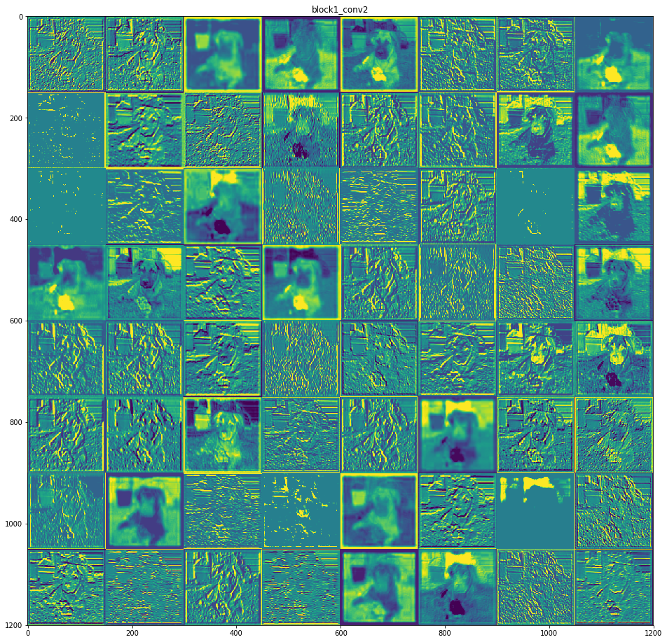
output
input
Block1_conv2

Slide 39
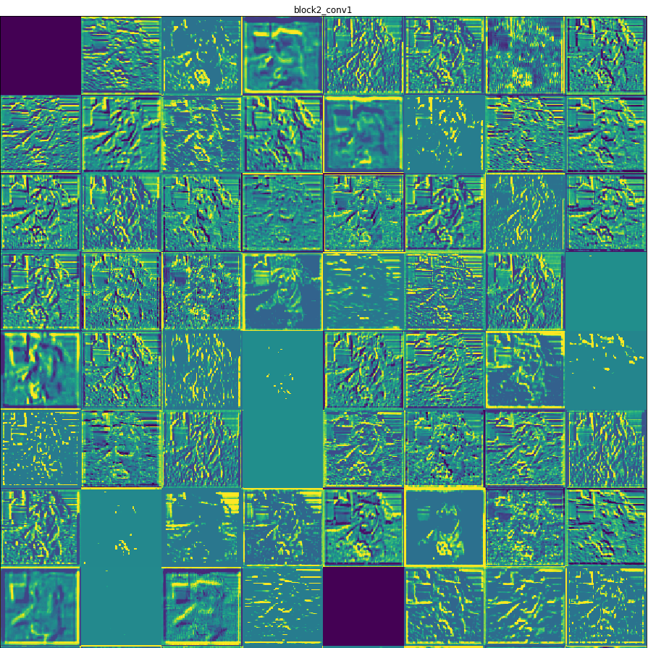
output
input
Block2_conv1

Slide 40
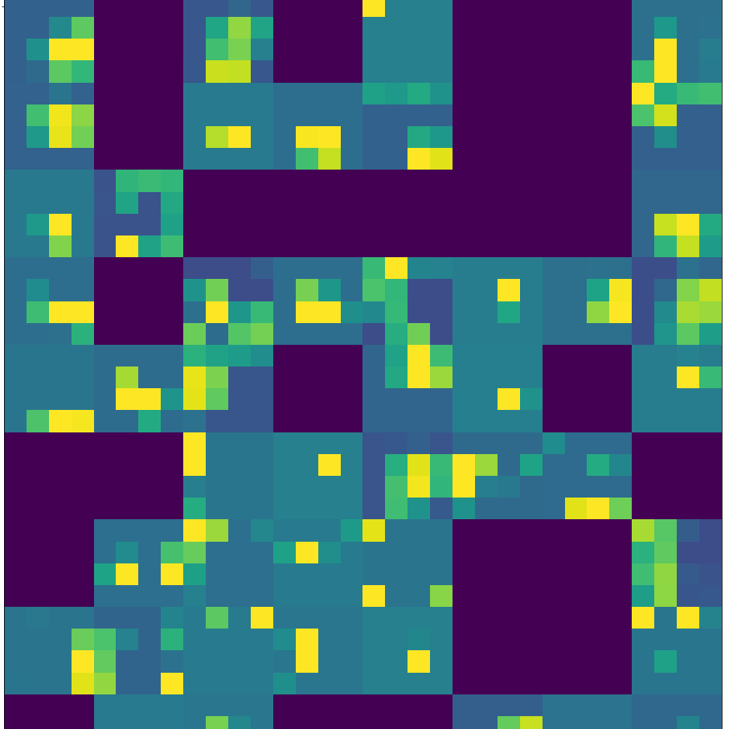
output
input
Block5_conv5

Slide 41
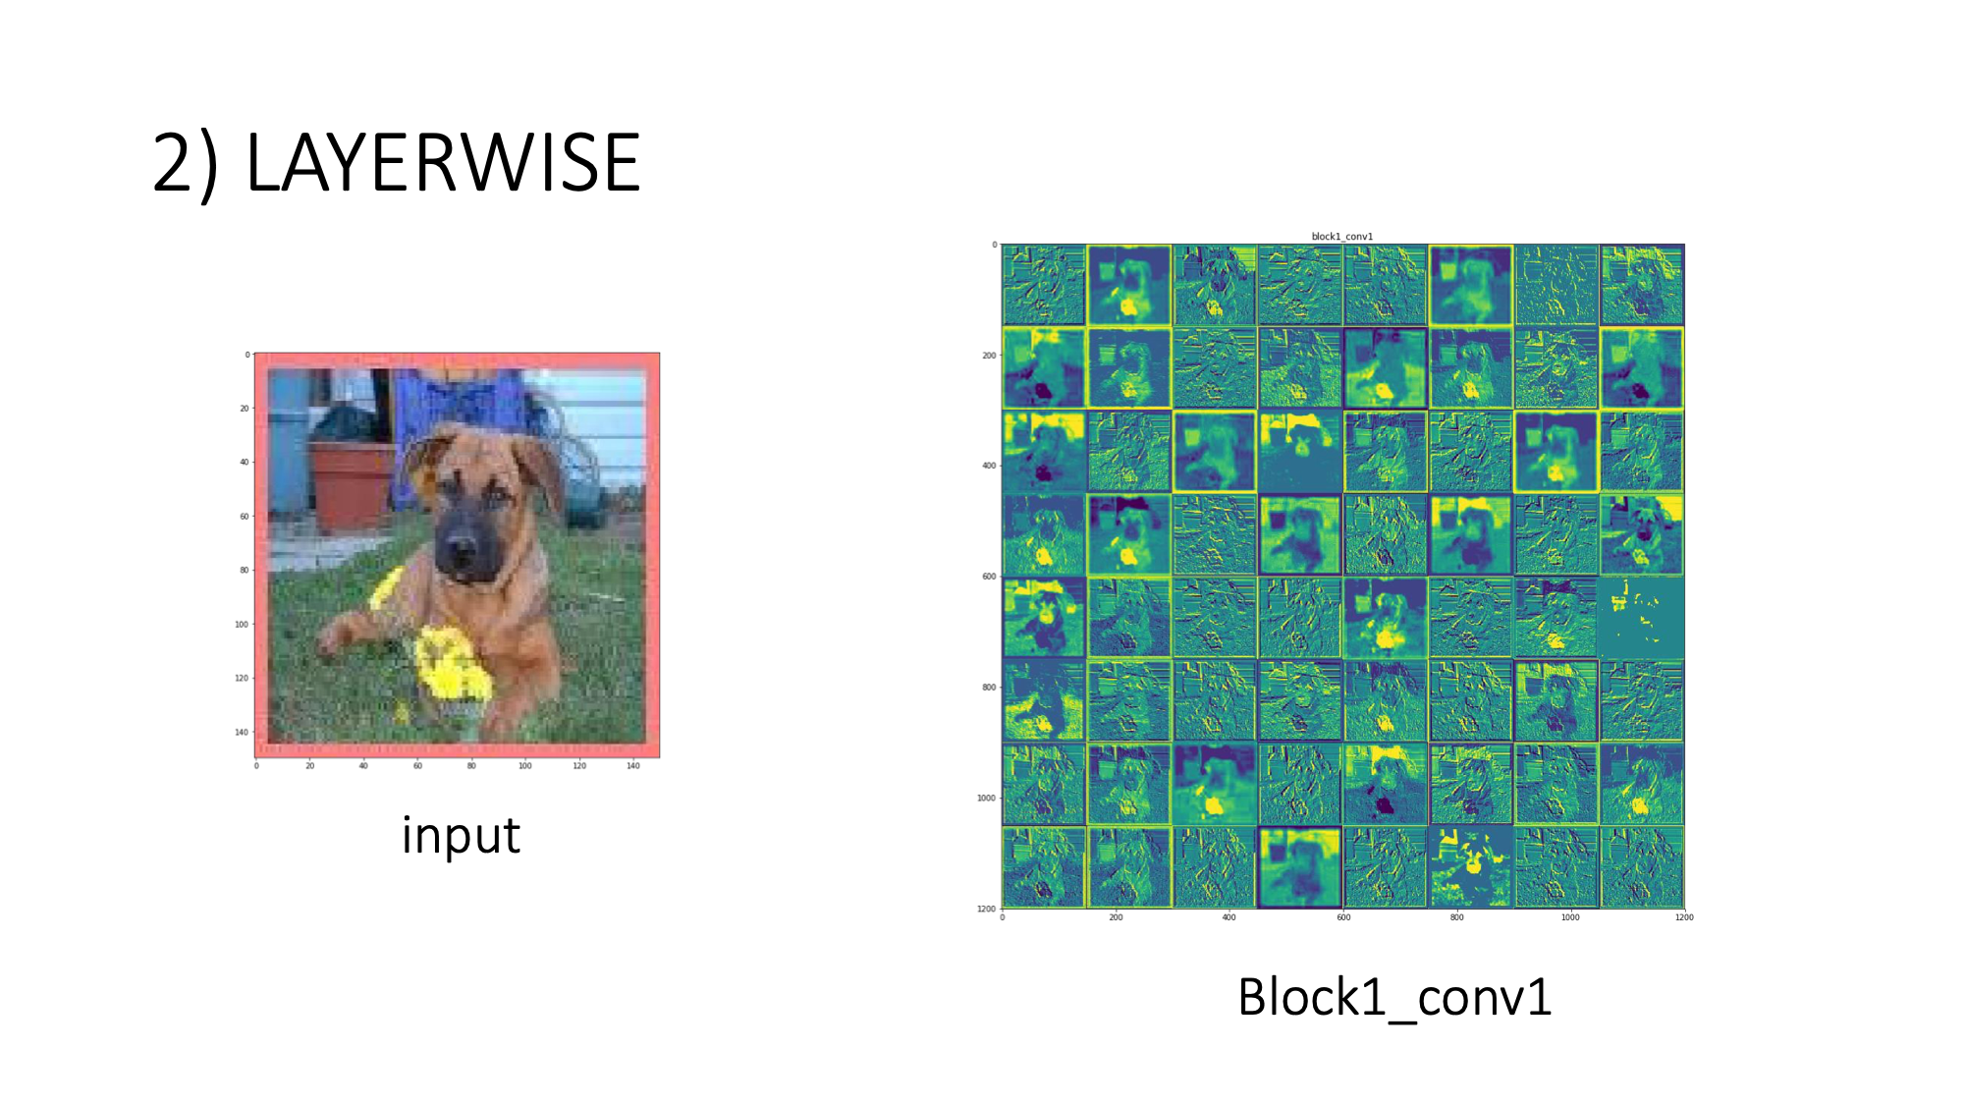

Slide 42
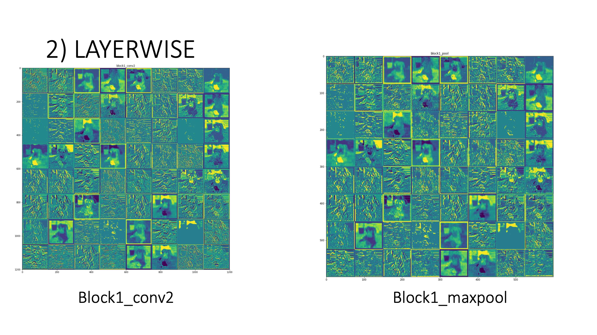

Slide 43
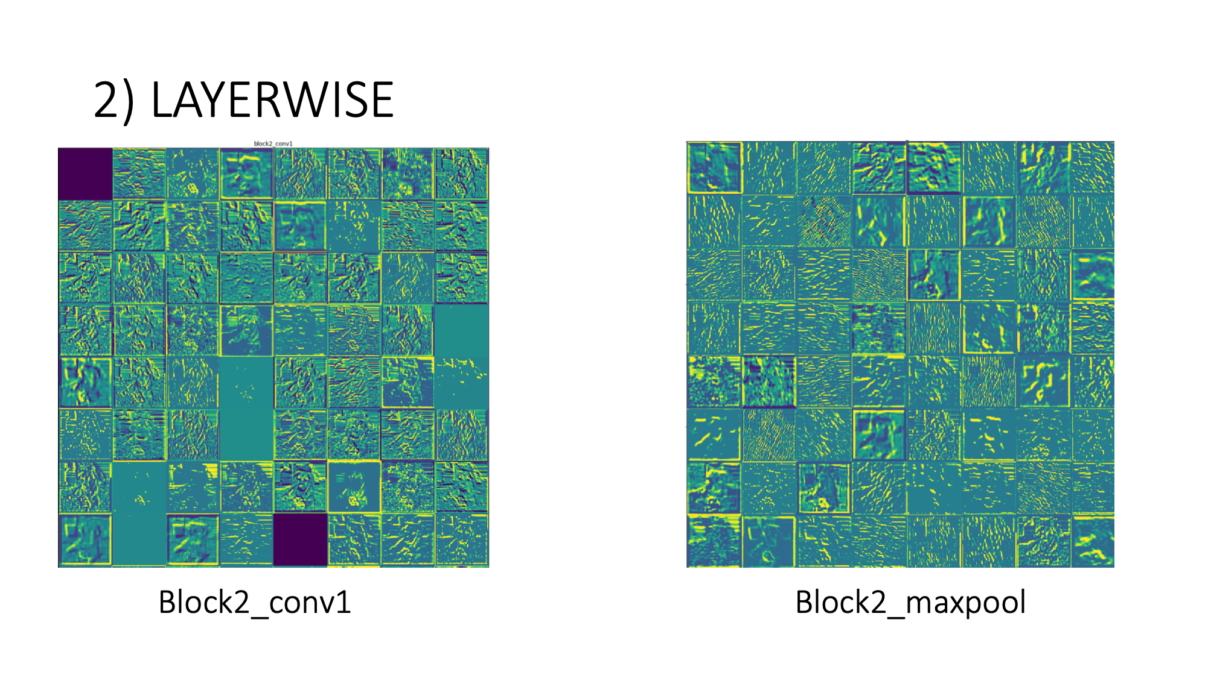

Slide 44
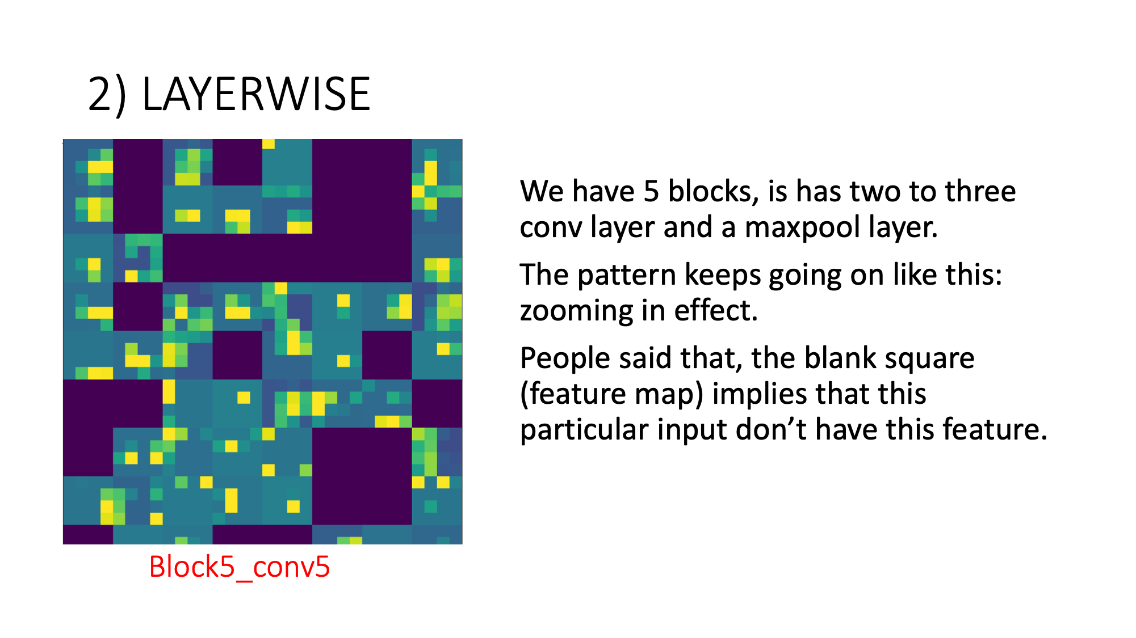

Slide 45
Overall architecture of CNN
https://world4jason.gitbooks.io/research-log/content/deepLearning/CNN/Model%20&%20ImgNet/lenet.html

Slide 46
Any questions?

Slide 47
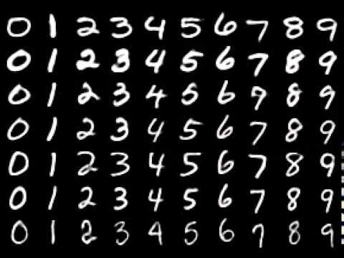
Lets get our hands wet through coding using MNIST data set
How to set up google colab
https://towardsdatascience.com/getting-started-with-google-colab-f2fff97f594c
28x28 pixels grayscale images
60,000 images for training
10,000 images for testing

Slide 48
Survey please. Thank you.
https://docs.google.com/spreadsheets/d/1PIIhsYQ-Gl2OT8M7H2-g6XCAvFkLsOX-zCcncSUNceA/edit?usp=sharing

